Slide 1

GRADUATE
LINKER
MT Lubisi
218025207

Slide 2

INTRODUCTION
Unemployment in South Africa is a pressing issue characterized by a significant number of individuals, more especially the youth who are unable to secure employment.

Slide 3
PROBLEM DESCRIPTION
Graduate unemployment is a significant issue in South Africa, with a large number of university graduates struggling to find employment in their chosen fields.
One of the main challenges facing graduates is searching for job opportunities that match their skill set.
Finding the right job is a daunting task.
Many graduates end up settling for jobs outside their chosen fields or accept positions that are below their qualifications.
This can lead to a mismatch between the skills and qualifications of the graduate and the requirements of the job, making it harder for them to secure employment.

Slide 4
PROPOSED SOLUTION
Model a solution using a graph-based approach with pathfinding algorithms to match graduates with potential employers in an efficient and effective way.
The Nodes Vertices will store the Employers and Graduates.
The edges represent the relationship between them.
Dijkstra shortest path algorithm is used to match a graduate to a the employer.

Slide 5
How the System Works
Employers in the Graph: To start, there are employers loaded into the graph. These are companies looking for fresh talent - graduates to fill their open positions.
Graduate Enters the Scene: Now, imagine a graduate comes into the picture. They're eager and ready to start their career, but finding the right job is a daunting task.
Before we even add them to the graph, we're going to check if their skills and qualifications match what any of the employers are looking for.
Making the Connections: If the graduate's skills and qualifications fit what an employer needs, we create a connection between them in our graph. We repeat this for all employers whose requirements match the graduate's qualifications.

Slide 6

Graphical User Interface

Slide 7
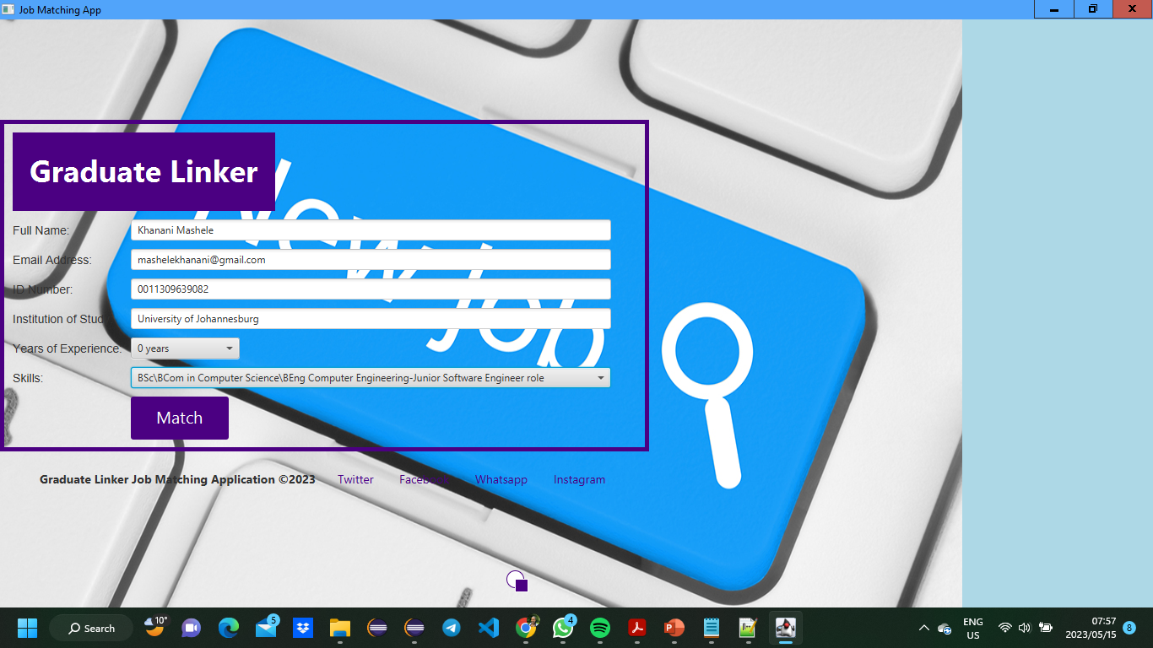

Slide 8
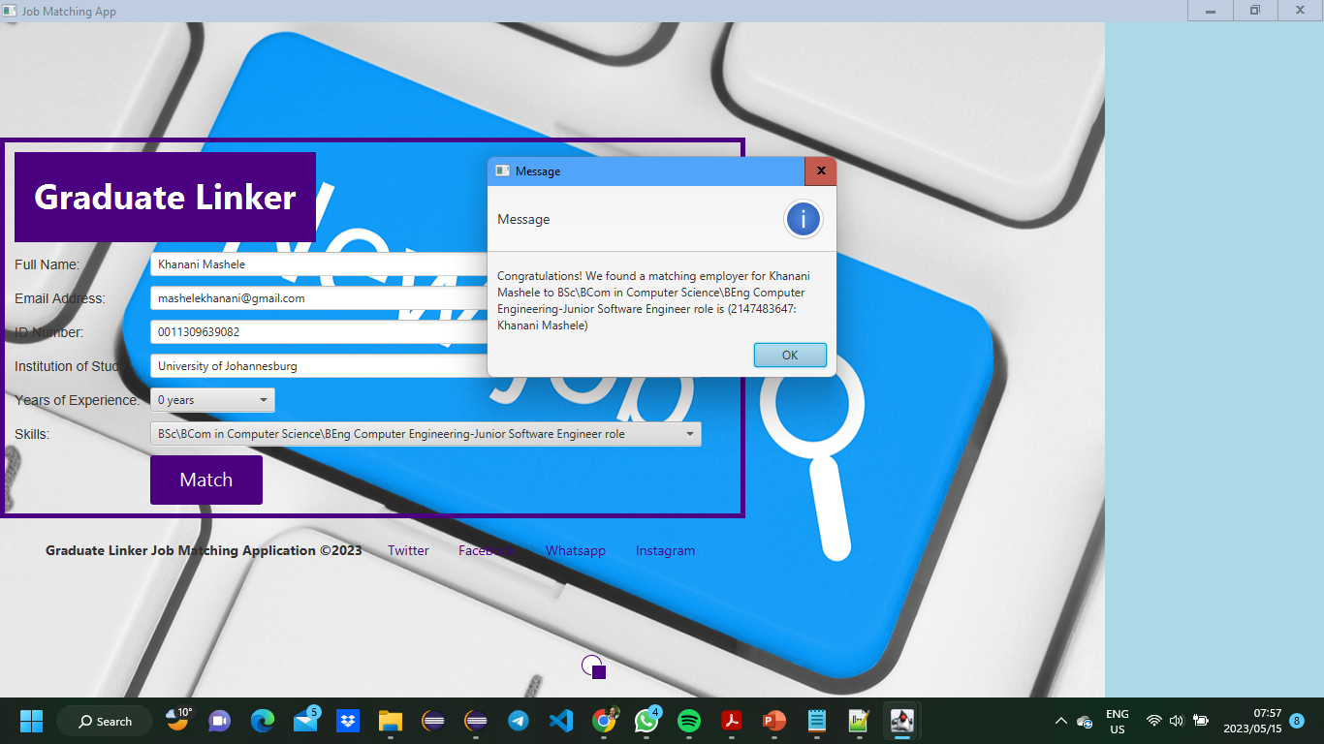

Slide 9
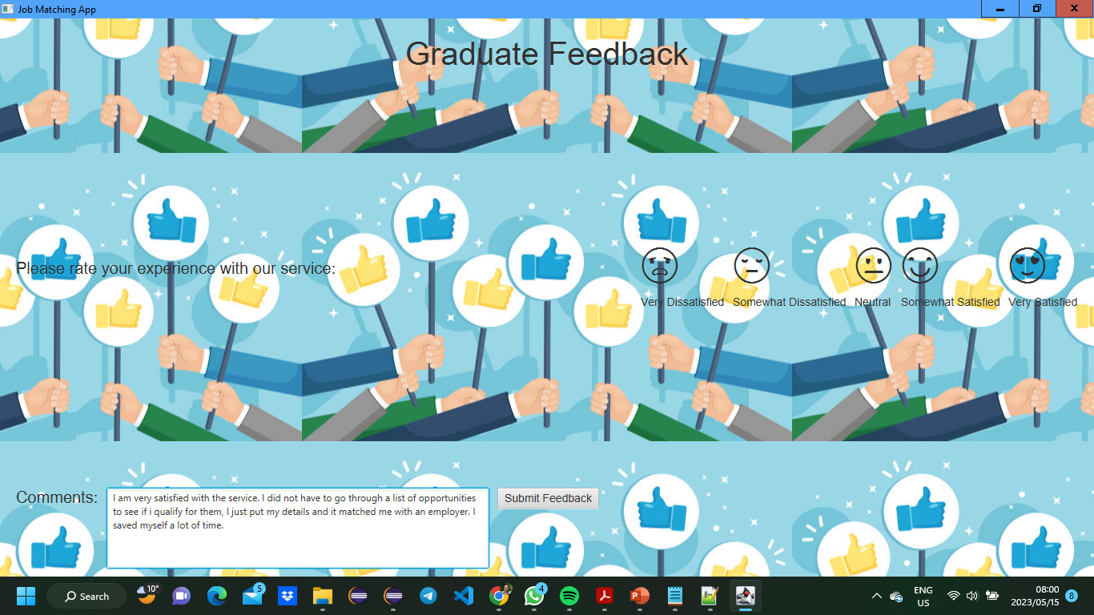

Slide 10

Project Demonstration

Slide 11


Conclusion

Slide 12

Thank You!!!

